Slide 1
Manipulating Strings & Arrays
Source of Material:
JAVASCRIPT (6th Edition) by Sasha Vodnik and Don Gosselin
Publisher: Course Technology (Cengage Learning)

Slide 2
Learning Objectives
Manipulate strings with properties and methods of the String object
Create regular expressions and use them to validate user input
Manipulate arrays with properties and methods of the Array object
Convert between strings and arrays, and between strings and JSON

Slide 3
Manipulating Strings
String
Text contained within double or single quotation marks
Literal values or assigned to a variable
Begin and end with same type of quotation mark
Example:
document.getElementById("mainHeading").innerHTML = "24-Hour Forecast";
var highSurfAdvisory = "Watch out for high waves and strong rip currents.";

Slide 4
Manipulating Strings (cont’d.)
Parsing
Extracting characters or substrings from a larger string
Use String class to parse text strings in scripts
Represents all literal strings and string variables in JavaScript
Contains methods for manipulating text strings

Slide 5
Formatting Strings
Using special characters
For basic types: use escape sequences
var mainHead = 'Today\'s Forecast';
For other special characters: use Unicode
Standardized set of characters from many of the world’s languages
copyrightInfo = "<p>&#169; 2006-2017</p>";
^{// numeric character ref.}
copyrightInfo = "<p>&copy; 2006-2017</p>";
^{// character entity}

Slide 6
Formatting Strings (cont’d.)
Using special characters (cont’d.)
fromCharCode() method
Constructs a text string from Unicode character codes
Syntax:
String.fromCharCode(char1, char2, ...)
Examples:
String.fromCharCode(74,97,118,97,83,99,114,105,112,116)
copyrightInfo = String.fromCharCode(169) + " 2017";

Slide 7
Formatting Strings (cont’d.)
Changing case
toLowerCase() and toUpperCase() methods
Examples:
^{var agency = "noaa";}
agencyName.innerHTML = agency.toUpperCase();
// browser displays "NOAA" but value of agency is still "noaa"
^{var agency = "noaa";}
^{agency = agency.toUpperCase();}
^{// value of agency is "NOAA"}
^{agencyName.innerHTML = agency;}
^{// browser displays "NOAA"}

Slide 8
Counting Characters in a String
length property
Returns the number of characters in a string
Example:
var country = "Kingdom of Morocco";
var stringLength = country.length;
^{// value of stringLength is 18}

Slide 9
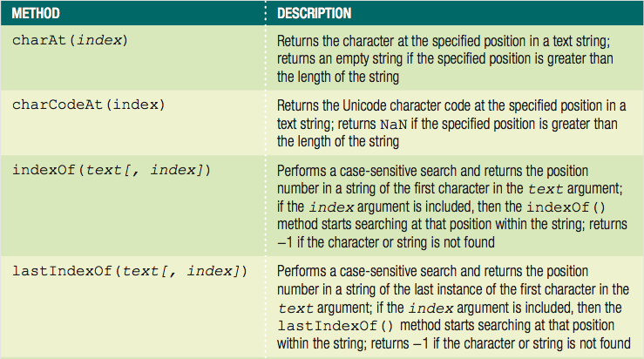
Finding and Extracting Characters and Substrings
Table: Search and extraction methods of the String class (continues)

Slide 10
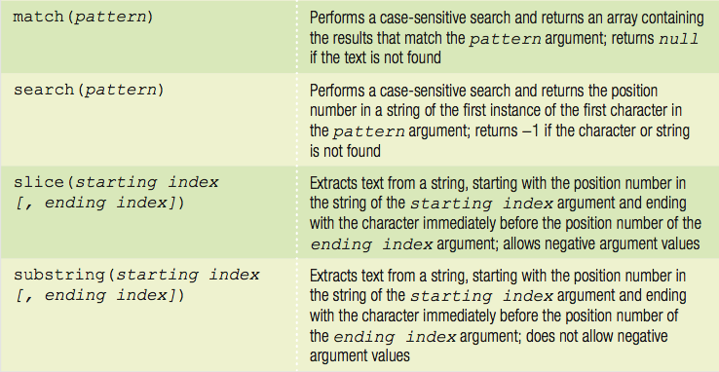
Finding and Extracting Characters and Substrings (cont’d.)
Table: Search and extraction methods of the String class

Slide 11
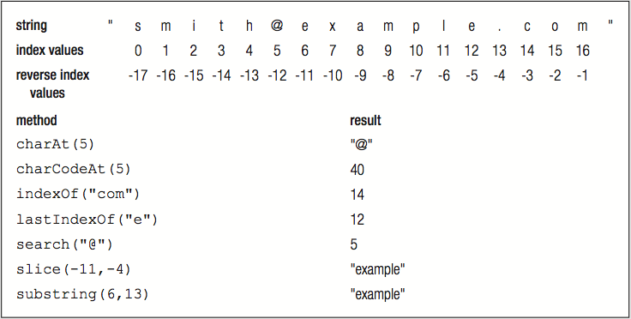
Finding and Extracting Characters and Substrings (cont’d.)
Figure: Example uses of String class methods

Slide 12
Finding and Extracting Characters and Substrings (cont’d.)
Two types of string search methods
Those that return a numeric position in a text string
Character position in text string begins with a value of zero
Can pass a second optional argument specifying the position in the string to start searching to the indexOf() method
Example: search() method
var email = "president@whitehouse.gov";
var atPosition = email.search("@"); // returns 9

Slide 13
Finding and Extracting Characters and Substrings (cont’d.)
Two types of string search methods (cont'd.)
Those that return a numeric position in a text string (cont'd.)
Example: indexOf() method
var email = "president@whitehouse.gov";
var atIndex = email.indexOf("@", 10); // returns -1

Slide 14
Finding and Extracting Characters and Substrings (cont’d.)
Two types of string search methods (cont’d.)
Those that return a character or substring
substring() or slice() method
var email = "president@whitehouse.gov";
var nameEnd = email.search("@");
^{// value of nameEnd is 9}
var nameText = email.substring(0, nameEnd);
// value of nameText is "president"

Slide 15
Finding and Extracting Characters and Substrings (cont’d.)
Extracting characters from the middle or end of a string
Use the search(), indexOf(), lastIndexOf() methods along with methods that return a character or substring
lastIndexOf() method returns position of the last occurrence of one string in another string
Example:
var email = "president@whitehouse.gov";
var startDomainID = email.lastIndexOf(".");
^{// startDomainID value is 20}
var domainID = email.substring(startDomainID + 1);
^{// domainID value is "gov"}

Slide 16
Finding and Extracting Characters and Substrings (cont’d.)
slice() method allows negative argument values for the index arguments
Specifying a negative value for the starting index
slice() method starts at the end of the text string
Specifying a negative value for the ending index
Number of characters the slice() method extracts also starts at the end of the text string
slice() method does not return the character represented by the ending index
Returns the character immediately before the ending index

Slide 17
Finding and Extracting Characters and Substrings (cont’d.)
var email = "president@whitehouse.gov";
var nameText = email.slice(0,9);
// nameText value is "president"
var domain = email.slice(-14,-4);
// domain value is "whitehouse"

Slide 18
Replacing Characters and Substrings
replace() method
Creates a new string with the first instance of a specified pattern replaced with the value of the text argument
Syntax: string.replace(pattern, text)
Example:
var email = "president@whitehouse.gov";
var newEmail = email.replace("president", "vice.president");
// value of newEmail is "vice.president@whitehouse.gov"

Slide 19
Combining Characters and Substrings
Combining strings
Use the concatenation operator (+) and compound assignment operator (+=)
Use the concat() method
Creates a new string by combining strings passed as arguments
Syntax: string.concat(value1, value2, ...)
To combine text strings
Easier to use the concatenation operator and the compound assignment operator

Slide 20
Combining Characters and Substrings (cont’d.)
var name = "Theodor Seuss Geisel";
^{var penName = "Dr. Seuss";}
var bio = penName.concat(" was the pen name of ", name);
^{// value of bio is}
// "Dr. Seuss was the pen name of Theodor Seuss Geisel"
var name = "Theodor Seuss Geisel";
^{var penName = "Dr. Seuss";}
var bio = penName + " was the pen name of " + name;
^{// value of bio is}
// "Dr. Seuss was the pen name of Theodor Seuss Geisel"

Slide 21
Comparing Strings
Comparison operator (===) can be used with strings
Compare individual characters according to their Unicode position
localeCompare() method
Compares strings according to the particular sort order of a language or country
Performs a case-sensitive comparison of two strings

Slide 22
Working with Regular Expressions
Regular expressions
Patterns used for matching and manipulating strings according to specified rules
With scripting languages, most commonly used for validating submitted form data

Slide 23
Defining Regular Expressions in JavaScript
Regular expressions
Must begin and end with forward slashes
Example: ^{var urlProtocol = /https/;}
Approaches to creating regular expressions
Use regular expressions with several String class methods
Pass pattern directly to a method
Use the RegExp() constructor
Contains methods and properties for working with regular expressions in JavaScript

Slide 24
Defining Regular Expressions in JavaScript (cont’d.)
Approaches to creating regular expressions (cont’d.)
Syntax for creating a regular expression with the RegExp() constructor
var regExpName = new RegExp("pattern"[, attributes]);
Example:
var urlProtocol = new RegExp("https");
var url = "http://www.cengagebrain.com";
var searchResult = url.search(urlProtocol);
^{// returns -1}

Slide 25
Using Regular Expression Methods
RegExp object
Includes two methods
test() and exec()
test() method: returns a value of true
If a string contains text that matches a regular expression
Otherwise returns false value
Syntax: ^{var pattern = test(string);}
Real power of regular expressions
Comes from the patterns written

Slide 26
Writing Regular Expression Patterns
Hardest part of working with regular expressions
Writing the patterns and rules
Example:
var emailPattern = /^[_a-zA-Z\\-]+(\.[_a-zA-Z0-9\\-]+)*@[a-zA-Z0-9\\-]+(\.[a-zA-Z0-9\\-]+)*(\.[a-z]{2,6})$/;
var email = "president@whitehouse.gov";
^{var result;}
if (emailPattern.test(email)) {
^{result = true;}
^{} else {}
^{result = false;}
^{} // value of result is true}

Slide 27
Writing Regular Expression Patterns (cont’d.)
Regular expression patterns consist of literal characters and metacharacters
Metacharacters: special characters that define the pattern matching rules in a regular expression

Slide 28
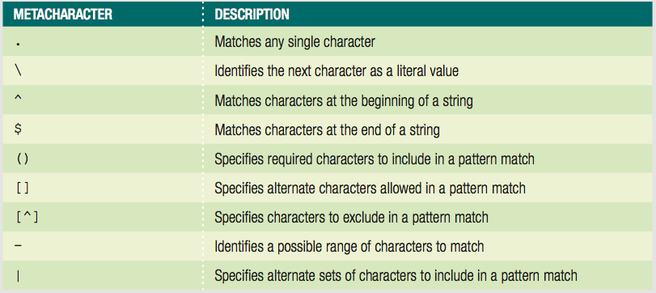
Writing Regular Expression Patterns (cont’d.)
Table: JavaScript regular expression metacharacters

Slide 29
Writing Regular Expression Patterns (cont’d.)
Matching any character
Period (.)
Matches any single character in a pattern
Specifies that the pattern must contain a value where the period located
Matching characters at the beginning or end of a string
^ metacharacter
Matches characters at the beginning of a string
$ metacharacter
Matches characters at the end of a string

Slide 30
Writing Regular Expression Patterns (cont’d.)
Matching characters at the beginning or end of a String (cont’d.)
Anchor
Pattern that matches the beginning or end of a line
Specifying an anchor at the beginning of a line
Pattern must begin with the ^ metacharacter
Matching special characters
Precede the character with a backslash

Slide 31
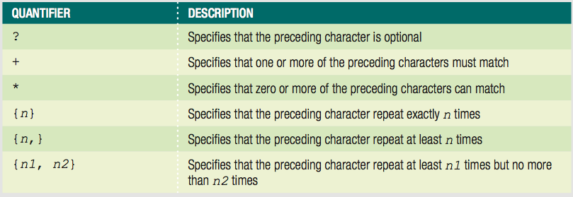
Writing Regular Expression Patterns (cont’d.)
Specifying quantity
Quantifiers
Metacharacters that specify the quantity of a match
Table: JavaScript regular expression quantifiers

Slide 32
Writing Regular Expression Patterns (cont’d.)
Specifying subexpressions
Subexpression or subpattern
Characters contained in a set of parentheses within a regular expression
Allows determination of the format and quantities of the enclosed characters as a group

Slide 33
Writing Regular Expression Patterns (cont’d.)
Defining character classes
Character classes
Used in regular expressions to treat multiple characters as a single item
Created by enclosing the characters that make up the class with bracket [] metacharacters
Use a hyphen metacharacter (-) to specify a range of values in a character class
To specify optional characters to exclude in a pattern match
Include the ^ metacharacter immediately before the characters in a character class

Slide 34
Writing Regular Expression Patterns (cont’d.)
var emailPattern = /^[_a-zA-Z0-9\\-]+(\.[_a-zA-Z0-9\\-]+)*↵
@[a-zA-Z0-9\\-]+(\.[a-zA-Z0-9\\-]+)*(\.[a-z]{2,6})$/;
var email = "president@whitehouse.gov";
^{var result;}
if (emailPattern.test(email)) {
^{result = true;}
^{} else {}
^{result = false;}
}
^{// value of result is true}

Slide 35
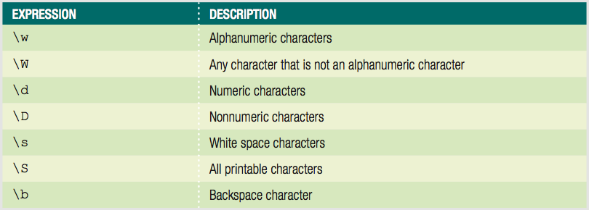
Writing Regular Expression Patterns (cont’d.)
Defining character classes (cont’d.)
Regular expressions include special escape characters in character classes
To represent different types of data
Table: JavaScript character class expressions

Slide 36
Writing Regular Expression Patterns (cont’d.)
Defining character classes (cont’d.)
Matching multiple pattern choices
Allow a string to contain an alternate set of substrings
Separate the strings in a regular expression pattern with the | metacharacter

Slide 37
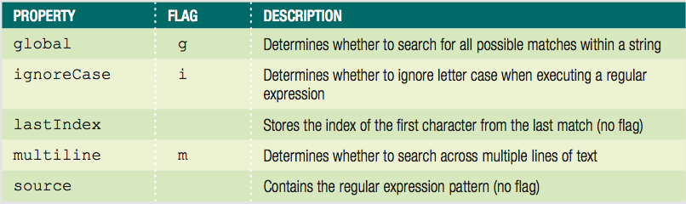
Setting Regular Expression Properties
Table: Properties of the RegExp object

Slide 38
Setting Regular Expression Properties (cont’d.)
Options for setting the values of these properties
Assign a value of true or false to the property
By creating a regular expression with the RegExp() constructor
Use the flags when assigning a regular expression to a variable without using the RegExp() constructor

Slide 39
Manipulating Arrays
Use the Array class length property and methods
Creating an array
Instantiates an object from the Array class

Slide 40
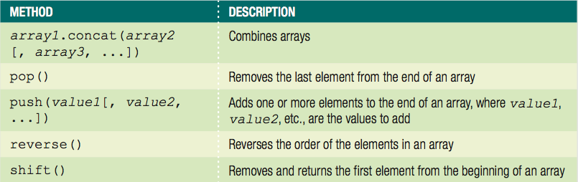
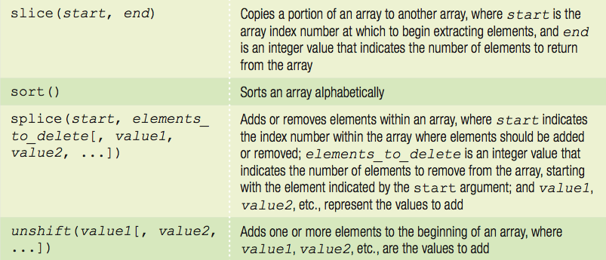
Manipulating Arrays (cont'd.)
Table: Methods of the Array class

Slide 41
Finding and Extracting Elements and Values
Primary method for finding a value in an array
Use a looping statement to iterate through the array until a particular value found
Extract elements and values from an array
Use the slice() method to return (copy) a portion of an array and assign it to another array
Syntax for the slice() method
array_name.slice(start, end);

Slide 42
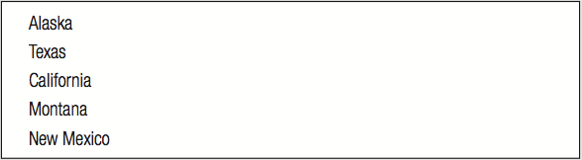
Finding and Extracting Elements and Values (cont’d.)
var largestStates = ["Alaska", "Texas", "California",↵
"Montana", "New Mexico", "Arizona", "Nevada",↵
"Colorado", "Oregon", "Wyoming"];
var fiveLargestStates = largestStates.slice(0, 5);
for (var i = 0; i < fiveLargestStates.length; i++) {
var newItem = document.createElement("p");
newItem.innerHTML = fiveLargestStates[i];
document.body.appendChild(newItem); }
Figure: List of states extracted using the slice() method

Slide 43
Manipulating Elements
Adding and removing elements to and from the beginning of an array
shift() method removes and returns the first element from the beginning of an array
unshift() method adds one or more elements to the beginning of an array

Slide 44
Manipulating Elements (cont’d.)
var colors = ["mauve", "periwinkle", "silver", "cherry",↵
^{"lemon"];}
colors.shift(); // colors value now
// ["periwinkle", "silver", "cherry", "lemon"]
colors.unshift("yellow-orange", "violet");
// colors value now ["yellow-orange", "violet",
// "mauve", "periwinkle", "silver", "cherry", "lemon"]

Slide 45
Manipulating Elements
Adding and removing elements to and from the end of an array
Use array’s length property to determine the next available index
var colors = ["mauve", "periwinkle", "silver", "cherry"];
colors[colors.length] = "lemon";
// colors value now ["mauve", "periwinkle", "silver",
^{// "cherry", "lemon"]}

Slide 46
Manipulating Elements (cont’d.)
Adding and removing elements to and from the end of an array (cont’d.)
pop() method removes the last element from the end of an array
push() method adds one or more elements to the end of an array
var colors = ["mauve", "periwinkle", "silver", "cherry"];
^{colors.pop();}
// colors value now ["mauve", "periwinkle", "silver"]
colors.push("yellow-orange", "violet");
// colors value now ["mauve", "periwinkle", "silver",
^{// "yellow-orange", "violet"]}

Slide 47
Manipulating Elements (cont’d.)
Adding and removing elements within an array
Use the splice() method
Also renumbers the indexes in the array
To add an element, include 0 as second argument
var hospitalDepts = ["Anesthesia", "Molecular Biology",↵
^{"Neurology", "Pediatrics"];}
hospitalDepts.splice(3, 0, "Ophthalmology");
// value now ["Anesthesia", "Molecular Biology",
// "Neurology", "Ophthalmology", "Pediatrics"]

Slide 48
Manipulating Elements (cont’d.)
Adding and removing elements within an array (cont'd.)
Use the splice() method (cont'd.)
To delete elements, omit third argument
Indexes renumbered just like when elements added
var hospitalDepts = ["Anesthesia", "Molecular Biology",↵
^{"Neurology", "Pediatrics"];}
^{hospitalDepts.splice(1, 2);}
// value now ["Anesthesia", "Pediatrics"]

Slide 49
Sorting and Combining Arrays
Sorting arrays
Sort elements of an array alphabetically
Use the sort() method
var scientificFishNames = ["Quadratus taiwanae",↵
"Macquaria australasica", "Jordania zonope",↵
"Abudefduf sparoides", "Dactylopterus volitans",↵
"Wattsia mossambica", "Bagrus urostigma"];
^{scientificFishNames.sort();}
// scientificFishNames value now
// ["Abudefduf sparoides", "Bagrus urostigma",
// "Dactylopterus volitans", "Jordania zonope",
// "Macquaria australasica", "Quadratus taiwanae",
^{// "Wattsia mossambica"]}

Slide 50
Sorting and Combining Arrays (cont'd.)
Sorting arrays (cont'd.)
reverse() method
Transposes, or reverses, the order of the elements in an array
^{scientificFishNames.reverse();}
// scientificFishNames value now
// ["Wattsia mossambica", "Quadratus taiwanae",
// "Macquaria australasica", "Jordania zonope",
// "Dactylopterus volitans", "Bagrus urostigma",
^{// "Abudefduf sparoides"]}

Slide 51
Sorting and Combining Arrays (cont'd.)
Combining arrays
Use the concat() method
Syntax
array1.contact(array2, array3, ...);

Slide 52
Sorting and Combining Arrays (cont'd.)
var Provinces = ["Newfoundland and Labrador",↵
"Prince Edward Island", "Nova Scotia",↵
"New Brunswick", "Quebec", "Ontario",↵
"Manitoba", "Saskatchewan", "Alberta",↵
^{"British Columbia"];}
var Territories = ["Nunavut", "Northwest Territories",↵
^{"Yukon"];}
^{var Canada = [];}
Canada = Provinces.concat(Territories);
// value of Canada now ["Newfoundland and Labrador",
// "Prince Edward Island", "Nova Scotia",
// "New Brunswick", "Quebec", "Ontario",
// "Manitoba", "Saskatchewan", "Alberta",
// "British Columbia", "Nunavut",
// "Northwest Territories", "Yukon"];

Slide 53
Converting Between Data Types
Common task to convert strings and arrays to different data types
strings to arrays
arrays to strings
objects to strings
strings to objects

Slide 54
Converting Between Strings and Arrays
split() method of the String class
Splits a string into an indexed array
Syntax
array = string.split(separator[, limit]);
To split individual characters in a string into an array
Pass an empty string ("") as the separator argument

Slide 55
Converting Between Strings and Arrays (cont’d.)
var OPEC = "Algeria, Angola, Ecuador, Iran, Iraq, Kuwait,↵
Libya, Nigeria, Qatar, Saudi Arabia,↵
United Arab Emirates, Venezuela";
// The value of OPEC is a string
var opecArray = OPEC.split(", ");
// The value of opecArray is the following array:
// ["Algeria", "Angola", "Ecuador", "Iran", "Iraq",
// "Kuwait", "Libya", "Nigeria", "Qatar", "Saudi Arabia",
// "United Arab Emirates", "Venezuela"]

Slide 56
Converting Between Strings and Arrays (cont’d.)
join() method of the Array class
Combines array elements into a string, separated by a comma or specified characters
Syntax
^{array.join(["separator"]);}
To prevent elements from being separated by any characters in the new string
Pass an empty string ("") as the separator argument

Slide 57
Converting Between Strings and Arrays (cont’d.)
var OPEC = ["Algeria", "Angola", "Ecuador", "Iran",↵
"Iraq", "Kuwait", "Libya", "Nigeria", "Qatar",↵
"Saudi Arabia", "United Arab Emirates", "Venezuela"];
^{// value of OPEC is an array}
^{var opecString = OPEC.join();}
// value of opecString is the following string:
// "Algeria, Angola, Ecuador, Iran, Iraq, Kuwait, Libya,
// Nigeria, Qatar, Saudi Arabia, United Arab Emirates,
^{// Venezuela"}

Slide 58
Converting Between Strings and Arrays
join() method does not include a separator argument
Previous example OPEC nations automatically separated by commas
Can include a separator argument of ";"
var OPEC = ["Algeria", "Angola", "Ecuador", "Iran",↵
"Iraq", "Kuwait", "Libya", "Nigeria", "Qatar",↵
"Saudi Arabia", "United Arab Emirates", "Venezuela"];
^{// value of OPEC is an array}
var opecString = OPEC.join(";");
// value of opecString is the following string:
// "Algeria;Angola;Ecuador;Iran;Iraq;Kuwait;Libya;
// Nigeria;Qatar;Saudi Arabia;United Arab Emirates;
^{// Venezuela"}

Slide 59
Converting Between Strings and Arrays (cont’d.)
Can also use the toString() and toLocaleString() method
Convert an array to a string
^{array.toString();}
^{array.toLocaleString();}

Slide 60
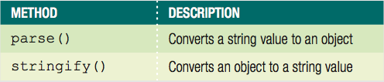
Converting Between Strings and JSON
JavaScript Object Notation (JSON)
Represents a JavaScript object as a string
Exchanges data between application and server
JSON object
Supported in modern browsers, including IE8
Table: Methods of the JSON object

Slide 61
Converting Between Strings and JSON (cont'd.)
Converting an Object to a String
stringify() method
string = JSON.stringify(value [, replacer [, space]]);
string is name of variable that will contain string
value represents JavaScript object to be converted

Slide 62
Converting Between Strings and JSON (cont'd.)
Converting an Object to a String (cont'd.)
^{var newUser = {}
^{fName: "Tony",}
^{lName: "Chu"}
},
newUserString = JSON.stringify(newUser);
^{// value of newUserString is}
// '{"fName":"Tony","lName":"Chu"}'

Slide 63
Converting Between Strings and JSON (cont'd.)
Converting a String to an Object
parse() method
object = JSON.parse(string [, function]);
object is namve of variable that will contain object
string represents JSON string to be converted

Slide 64
Converting Between Strings and JSON (cont'd.)
Converting a String to an Object (cont'd.)
JSON string definition:
String because enclosed in quotes
To convert string to JavaScript object:
var newUser = '{"fName":"Tony","lName":"Chu"}';
var newUserObject = JSON.parse(newUser);
^{// value of newUserObject is}
// {
^{// fName: "Tony",}
^{// lName: "Chu"}
// };

Slide 65
Summary
Parsing
Act of extracting characters or substrings from a larger string
All literal strings and string variables in JavaScript
Represented by the String class
fromCharCode() method of the String class
Constructs a text string from Unicode character codes
toLowerCase() and toUpperCase() methods
Change the case of letters in a string

Slide 66
Summary (cont’d.)
String class
length property
Methods: replace(), concat(), localeCompare()
Regular expressions
Patterns used for matching and manipulating strings according to specified rules
RegExp object
Contains methods and properties for working with regular expressions in JavaScript

Slide 67
Summary (cont’d.)
Use the Array class methods and length property to manipulate arrays in scripts
Methods: slice(), shift() and unshift(), pop() and push(), splice(), sort(), reverse(), concat(), and join()
split() method of the String class
Splits a string into an indexed array
join() method of the Array class
Combines array elements into a string

Slide 68
Summary (cont’d.)
Use the JSON class methods to convert between string values and object values
stringify() method of the JSON class
Converts JavaScript object to JSON string
parse() method of the JSON class
Converts JSON string to JavaScript object

